Slide 1
Objectives
To identify the peripherals of a computer, components in a CPU and its functions.

Slide 2
Software Requirement / Hardware Requirement
Software Requirement: No Software Required.
Hardware Requirement: Desired Configuration for the above task is
System unit
CPU
Mother Board
FDD
CD ROM Drive
HDD
Ethernet Card
Monitor, Keyboard, Mouse & Speakers

Slide 3
Safety Precautions
Safety Precautions:
1. Beware of electrostatic discharge (ESO)
2. Build computer on a hard surface, away from concepts.
3. Wear shoes and the short sleeved cotton wear.
4. Use Phillips, head screw driver.
5. Keep the components away from moisture.
6. Avoid using pressure while installing.

Slide 4
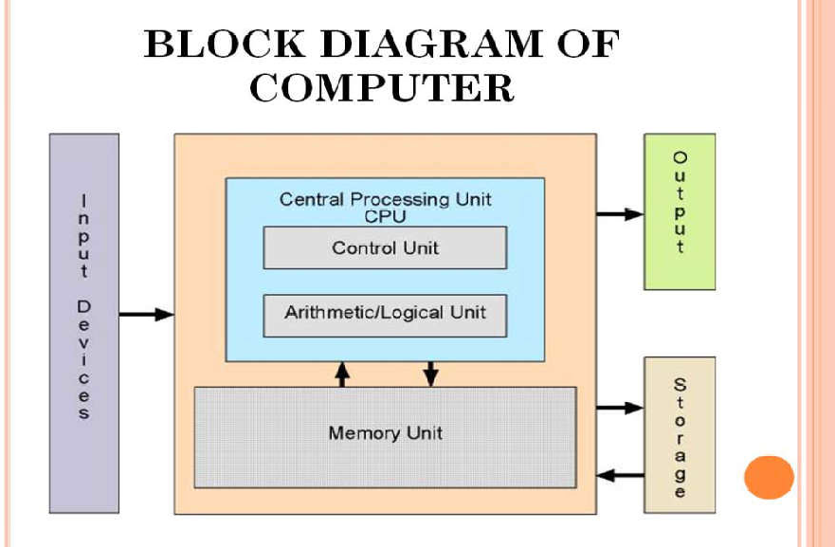
Block Diagram of Computer

Slide 5
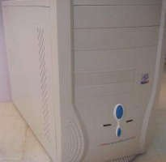
Peripherals of a computer
1. Cabinet:
It is used to install all hardware devices like(mother board, SMPS,HDD, CD Rom, FDD)
It has Start, Restart Button, Led’s, Audio and USB Connecters are available at front side.

Slide 6
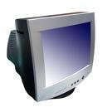
Peripherals of a computer
2. Monitor:
Monitor of a computer is like a television screen.
It displays text characters and graphics in colors or in shades of grey.
The monitor is also called as screen or display or CRT (cathode ray tube). In the monitor the screen will be displayed in pixels format.
800 by 600 pixels
1024 by 768 pixels

Slide 7
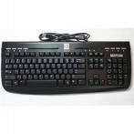
Peripherals of a computer
3. Key Board:
• Key board is like a type writer, which contains keys to feed the data or information into the computer
• Keyboards are available in two modules. These are
standard key board with 83-88 keys
enhanced key board with 104 keys or above

Slide 8
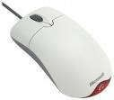
Peripherals of a computer
4. Mouse:
• Every mouse has one primary button (left button) and one secondary button (right button).
• The primary button is used to carry out most tasks, where as secondary button is used in special cases you can select commands and options

Slide 9

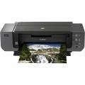
Peripherals of a computer
5. Printer:
• A device that prints images (numbers, alphabets, graphs, etc…) on paper is known as Printer.
• We have different types of printers to take printouts. These are as follows:
i. Dot matrix printer ii. Inkjet printer

Slide 10
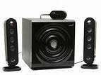
Peripherals of a computer
6. Speakers:
• Speakers make your system much more delightful to use entertain you while you are working on computer

Slide 11
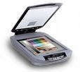
Peripherals of a computer
7. Scanner: Scanner used to scan images and text.

Slide 12
Peripherals of a computer
8. System board/Motherboard
• This is the major part of the PC hardware
• It manages all transactions of data between CPU peripherals.
• which holds the Processor, Random Access Memory and other parts, & has slots for expansion cards
• It is rectangle shape

Slide 13
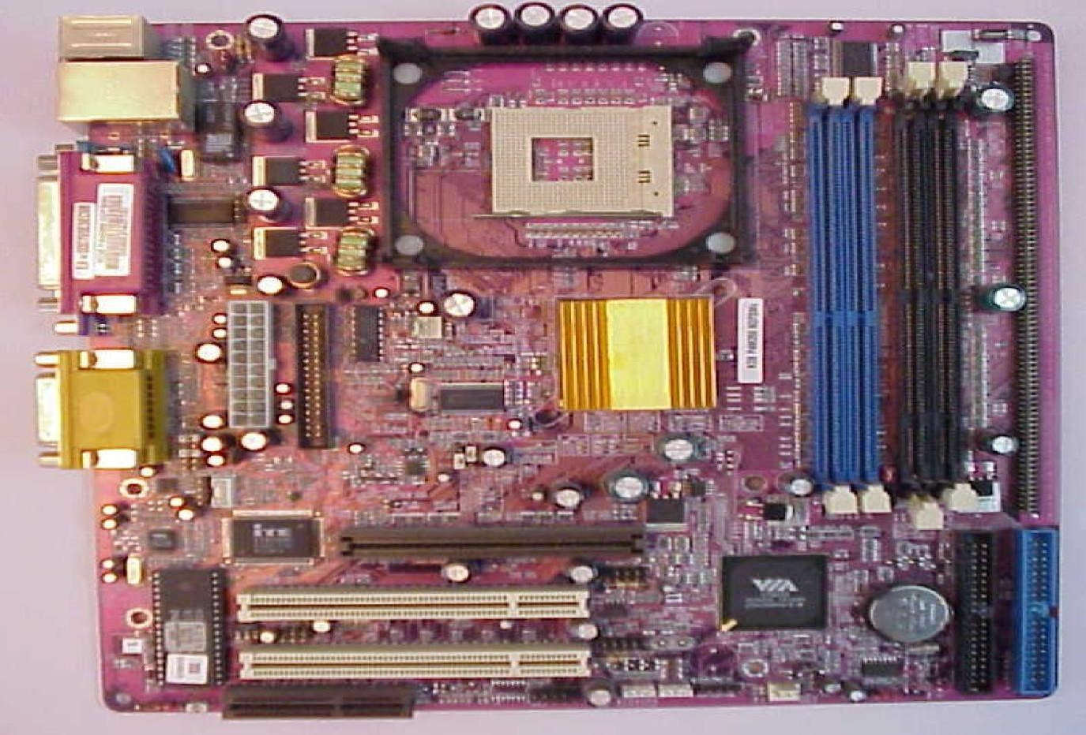
System board/Motherboard

Slide 14
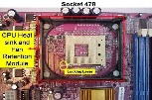
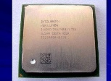
Peripherals of a computer
9. Socket 478:
It use 478 – PIN MICROPGA package it is used installing CPU It is square type design.
10. CPU
• The central processing unit contains the heart of any computer, the processor. The processor is fitted on to a Mother Board. The Mother Board contains various components, which support the functioning of a PC.
• It is brain of the computer
• It is square shape

Slide 15
Peripherals of a computer
11. Ram Slots:
• Ram slots are used to install the rams
• It is large rectangle shape and each ending has small clips.
• There two type ram slots
• SD Ram ----------Two Gaps (synchronous DRAM) is a generic name for various kinds of dynamic random access memory (DRAM) that are synchronized with the clock speed that the microprocessor is optimized for. This tends to increase the number of instructions that the processor can perform in a given time.
• DDR Ram --------One Gap (Double Data Rate Synchronous DRAM: A clock is used to read data from a DRAM. DDR memory reads data on both the rising and falling edge of the clock, achieving a faster data rate.)

Slide 16

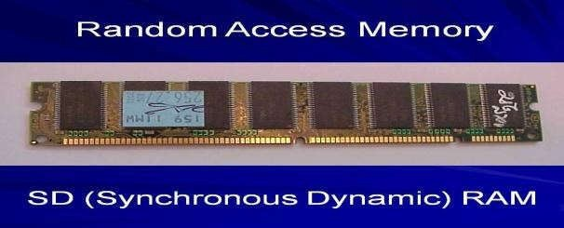
Ram Slots

Slide 17
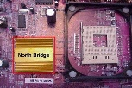
Peripherals of a computer
12. North Bridge:
• It is also called as controller
• It is nearby socket 478
• It placed middle of the mother board
• It converts electronic signals to binary values and binary values to electronic signals

Slide 18
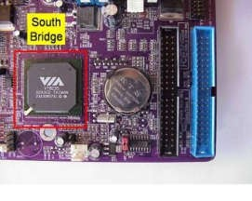
Peripherals of a computer
13. South Bridge:
• It is controls major components mother board and it back bone of the input out devices
• It is communicates PCI slots, IDE-1, IDE-2, floppy connecter, BIOS chip.
• It nearby CMOS battery

Slide 19
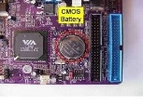
Peripherals of a computer
14. CMOS Battery:
• Computer is using a coin shape battery
• It generates the clock signal and it manage system continues time.

Slide 20
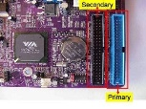
Peripherals of a computer
15. Primary & Secondary (IDE-1 & IDE-2):
• It is also called as IDE-1, IDE-2.
• It used to connecting Hard Disk Drive, CD ROM, DVD ROM.

Slide 21

Peripherals of a computer
16. Input & Output ports:
• IO ports are used to connecting IO device such as key boards, mouse, monitor, printer, scanner, speakers etc...

Slide 22
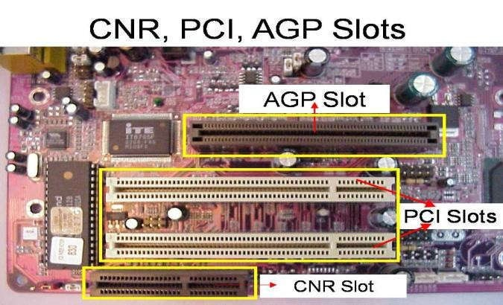
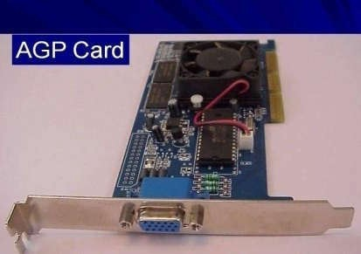
Peripherals of a computer
17. AGP Slot & AGP Card:
• AGP Slot is used install the AGP card.
• AGP back view same as VGA port (15-female pins) and used to connecting the monitor’s c. This slot is above PCI slots and its color is Black or Brown

Slide 23
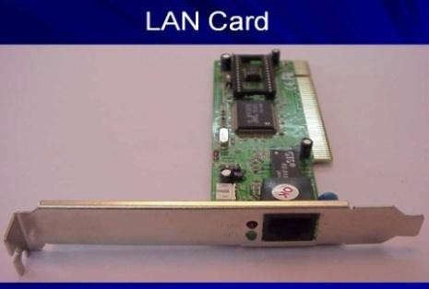
Peripherals of a computer
18. CI Slots &PCI (Expansion) Cards:
• PCI slots are used to install the PCI cards such as
i. LAN (Ethernet) Card---Back view Ethernet port

Slide 24
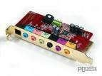
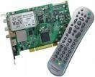
Peripherals of a computer
Sound Card- Back view Audio pin connectors)
iii. TV Tuner (Internal) Card - Dish Pin connecter
iv. PCI Slots are white or yellow color
v. PCI Card has Single gap only

Slide 25
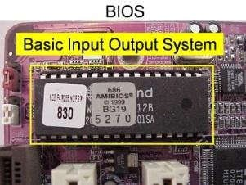
Peripherals of a computer
19. BIOS Chip:
• BIOS controls how the operating system and hardware wok together
• BIOS identification is BIOS name is available on chip or mother board

Slide 26
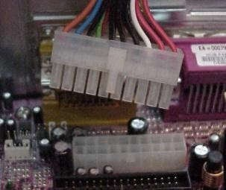
Peripherals of a computer
20. ATX Power connecter:
• ATX power connecter is used to connect ATX power plug (This is from SMPS)
• It is white color and it has ATX Name is available on Mother Board
• ATX Power connecter has 20/24 pins available.
• Typical ATX 1.3 power supply. From left to right, the connectors are 20-pin motherboard, 4-pin "P4connector", fan RPM monitor (note the lack of a power wire), SATA power connector (black), "Molex connector" and floppy connector.

Slide 27
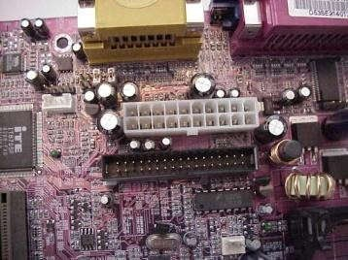
Peripherals of a computer
21. Floppy connecter:
• Floppy connecter is used to connect Floppy Disk Drive.
• This is beside of ATX power connecter and Name FDD is available on the mother board.

Slide 28
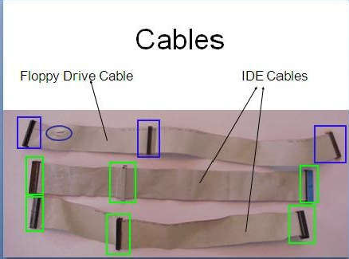
Peripherals of a computer
22. Bus Cables or Data cables:
• A Bus is a collection device cables are two types of wires through which data is transmitted from one device to another
• IDE cable: it used to connect HDD, CD ROM, DVD ROM
• FDD cable: it used to connect FDD (braking or manufacture defecting)

Slide 29

Peripherals of a computer
23. Hard Disk Drive:
• The hard disk drive is the main, and usually largest, data storage device in a computer
• The operating system, software titles and most other files are stored in the hard disk drive
• Identifications is the panel name is Hard Disk dive

Slide 30
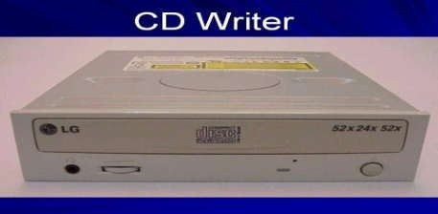
Peripherals of a computer
24. CD ROM Drive & CD-Writer:
• CD-Rom (Compact Disk Read only Memory) Drive is a device that reads the information from Compact Disks (CD).
• CD-Writer is used to write the data into Compact Disks.
• Identification is the panel name is CD Writer

Slide 31
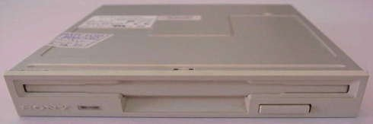
Peripherals of a computer
25. Floppy Disk Drive:
• The floppy disk drive is used to read the information stored in floppy disks.
• Floppy disks also called as a diskette.
• Identification is smaller than CD Writer.

Slide 32
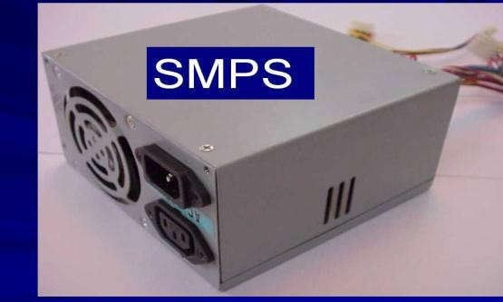
Peripherals of a computer
26. SMPS:
• SMPS is used to supply the power to Mother Board HDD,CD ROM, FDD
• In SMPS holds a transformer, voltage control and fan
• Identification is the rectangular box shape and panel name is switching mode power supply.

Slide 33
Reference
Reference
1. Hardware Bible by Winn L. Rosch
2. Hardware and Software of Personal Computers by Sanjay K. Bose
3. Fundamentals of Computers by V. Rajaraman
4. Computer Studies - A first course by John Shelley and Roger Hunt
5. Computer Fundamentals, MS Office and Internet & WebTechnology by Dinesh Maidasani
6. Modern Computer Hardware Course by M Lotia, P Nair, P Lotia

